Slide 1


Introduction to Digital
Transformation
and Robotic Process
Automation (RPA)

Slide 2
Digital Transformation: Definition and Key Concepts
Definition: Integration of digital technology into all business areas, transforming operations and value delivery
Key Concepts:
Customer Centricity
Data-Driven Decision Making
Agility and Innovation
Continuous Improvement

Slide 3
Drivers of Digital Transformation
Customer demand for seamless, personalized experiences
Competition and pressure to innovate
Technological advancements in RPA, cloud computing, AI, and data analytics
Regulatory changes requiring digital adoption
Economic benefits of improved efficiency and revenue growth
Cheaper
Better
Faster

Slide 4

Challenges of Digital Transformation
Resistance to change
Technical complexity
Data security and privacy concerns
Cost and budget constraints
Lack of leadership and vision (towards smart nation and digital economy)

Slide 5

Risks of Digital Transformation
Failure to achieve desired outcomes
Job displacement
Increased cyber security risks
Ethical and societal concerns)

Slide 6
Definition of RPA
Robotic Process Automation (RPA) is a technology that enables software robots or "bots" to automate repetitive, rule-based tasks that are typically performed by humans.

Slide 7
Types of RPA
Attended RPA: Requires human interaction to initiate and monitor the process.
Unattended RPA: Runs independently without human intervention.
Hybrid RPA: Combines attended and unattended RPA for complex processes.

Slide 8
Applications of RPA
Data entry and processing: Automating repetitive data entry tasks.
Customer service: Handling customer inquiries and resolving issues.
Financial operations: Processing invoices, payments, and reconciliations.
Supply chain management: Automating order processing, inventory management, and shipping.
Healthcare: Digitizing patient records, automating appointment scheduling, and processing insurance claims.

Slide 9
Benefits of RPA
Increased efficiency
Improved accuracy
Reduced costs
Increased compliance
Improved customer service

Slide 10
Limitations of RPA
Maintenance costs
Job displacement (after project implemented)
Security risks
Limited scope
High Implementation costs

Slide 11
How does RPA support Digital transformation?
Cloud Migration: perform some automated tasks like uploading into cloud environment
Data Analytics: RPA can do web scrapping, and these scrapped data can be used for deeper analytics insights.
AI and ML: Learn how they enhance decision-making.
RPA automation: Understand how it improves operational efficiency.

Slide 12
RPA use case
The NYC transformation office supports NYC in the digitalisation and transformation roadmap. One of the painpoints that they have identified was the mundane processes in the e-filing and tracking of the documents created by end users in their SharePoint workspace.
Every month, many files are created by business users in NYC. These files come in various sizes, file extensions and format. The e-registry record manager will need to track them and ensure that they are not videos or larger than a certain file size. These processes are tedious and time consuming.

Slide 13
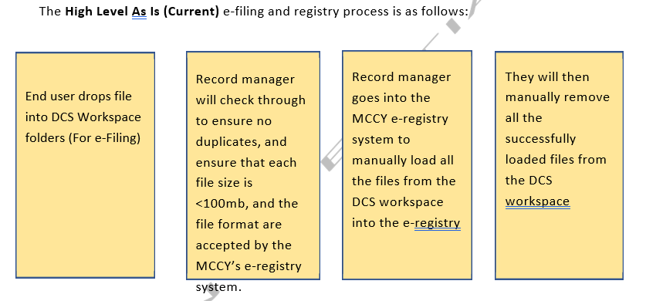
RPA use case
Overview of Current Processes in National Youth Council (as of 2023)

Slide 14
RPA use case Overview of TO-BE Processes
Bot3 check for error
To store information of error in log, and continue with the next file for uploading
Bot3 copies each files from DCS Workspace and transfers files to E-registry
Yes
Bot1 Creates a summary report (list of files, folders and file owner, status) and store it in DCS Workspace
Bot1 sends the link of the stored report in DCS Workspace to RM for review
Bot2 identify every document in each folder uploaded by record owner in sharePoint and bring them to the local machine
1. File size up to 100MB
2. File format is not video formats (.mp4, .mov, .wmv, .avi, .flv, swf, mkv, mpeg-2)
RPA Bot
No
Bot3 confirms file paths matches with file path branch logic, validates if file path exist.
Deletes only processed files stored in DCS Workspace.
Check the date and filename in DCS Workspace against the previous summary report to ensure there is no duplicated file that was already uploaded
No
Bot1 Sent email to RM
Bot to check if Element Exist for E-reg web app. If connection error, Try Catch, else, stop and sends report to RM
yes
Sends report to RM on status of processed files + files with errors (with filepath). Includes summary (count of files etc)
Bot2 will look through and list out all the files that can/cannot be uploaded to e-reg
With details of filesize, filedirectory, last edit, file format
Bot1 Reads current folder Name in DCS Workspace and Summary Report (list of files uploaded in previous month)
Bot3 access E-reg Web Application
Record
mgr
RM inform RO to remove duplicate folder
RM review report and trigger Bot2
RM review the lists and trigger Bot3
End
Record
owner
Team drops file into DCS Workspace (For Filing) folder
start

Slide 15
Attended Bot 1 – Tracking and Summarising
The purpose of this RPA Bot 1 is to automate the process of summarising and tracking of all the files in all the folders and sub-folders within the specified DCS workspace (SharePoint) used by NYC.
This is to ensure that we move all the correct files deposited by business users properly out from the DCS workplace to a local machine and to check with the list of all existing files in MCCY’s eRegistry system.
Bot1 will then list out all the files that can/cannot be uploaded to the e-Registry system with details of filesize, filedirectory, last edit, file format in excel.

Slide 16
Attended Bot 2 – Tracking and Summarising
Bot 2 has a primary role to migrate the documents identified by Bot1 from the SharePoint over to the local machine.
A comprehensive list of all existing files in a particular e-registry folders will be checked by bot2. This will be required by the Bot2 as it will be updated once it has been moved to the local machine.
Bot 2 will also show a list of all the recent moved files for tracking purpose. This is also to ensure that we know all the files in the “ToBeTransferredToERegistry” are being processed or not.

Slide 17
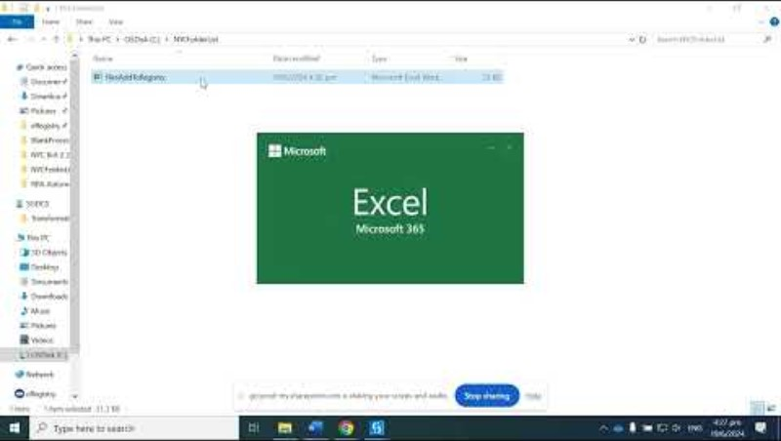
UiPath in action – NYC eRegistry bot 1 and 2
Notes:
https://youtu.be/LuPi432b-cQ

Slide 18
Attended Bot 3 – UI Automation & computer vision
The purpose of this Bot 3 is to mimic human and automate the steps of the manual task of the officer in charge
e.g mimic human actions like copying information, pasting information, and typing all the unique file paths into text boxes of file explorer or the e-Registry system.
Bot 3 will first leverage all the information gathered by Bot1 and Bot2 and go to the specific folders in the local machine and get the corresponding files. Then, it will launch a file explorer interface. This is required for accessing MCCY’s eRegistry.
The Bot3 will analyse the file location of the current files in the local machine, then key in the file path required to go into the new location in eRegistry.

Slide 19
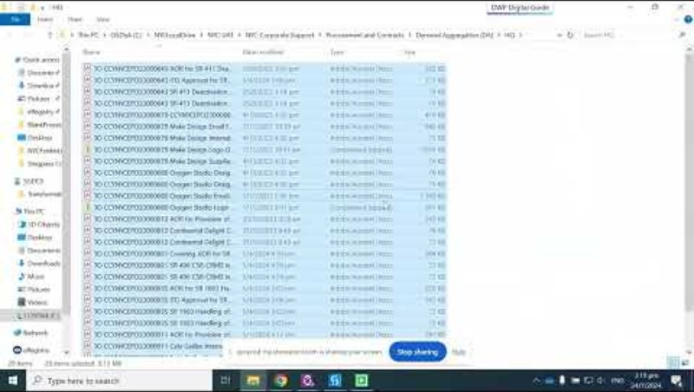
UiPath in action – NYC eRegistry bot 3
Notes:
https://youtu.be/LuPi432b-cQ

Slide 20

UiPath in action – NYC eRegistry bot 1 to 3 Going onto Production in UiPath Assistant

